Slide 1


Personal Key Indicators of Heart Disease
--use machine learning to predict risk of heart disease
Group 2: Jumao Huang, Xiaotong Lin, Yumeng Zhang
2022/5/26
Notes:
大家晚上好，我们组project的内容主要使用机器学习方法预测心脏病风险并寻找关键的indicators，组员有黄桔茂、林晓彤和张昱朦。

Slide 2

Background
Heart disease
One of the leading causes of death for people of most races in the US.
About half of all Americans have at least 1 of 3 key risk factors: high blood pressure, high cholesterol, and smoking.
Other factors: diabetic status, obesity, not getting enough physical activity or drinking too much alcohol
Dataset
The dataset comes from CDC and is a major part of the Behavioral Risk Factor Surveillance System (BRFSS), which conducts telephone surveys to gather data on the health status of U.S.
The most recent dataset (as of February 15, 2022) consists of 401,958 rows and 279 columns from 2020.
The original dataset of nearly 300 variables was reduced to just about 20 variables.
https://www.kaggle.com/datasets/kamilpytlak/personal-key-indicators-of-heart-disease
Notes:
心脏病Heart disease是全美各族人群中首要的死因之一，大概一半左右的美国人都有至少一个心脏病的的重要指征：高血压，高胆固醇和吸烟。当然其它像糖尿病、肥胖、缺乏锻炼等都会影响患心脏病的风险。我们选用的数据集来源于CDC的一个叫Behavioral Risk Factor Surveillance System 的项目，截止今年收集了2020年以来40多万人的健康状况。原始的数据集包括近300个变量，经缩减后剩下20个重要的predictors，该数据集也发布在了kaggle网站上。

Slide 3
Exploratory Data Analysis
Visualization of Continuous Data
HeartDisease
Respondents that have reported having coronary heart disease (CHD) or myocardial infarction (MI).
BMI
Body Mass Index (BMI)
PhysicalHealth
How many days during the past 30 days was your physical health not good? (0-30 days).
MentalHealth
How many days during the past 30 days was your mental health not good? (0-30 days).
SleepTime
How many hours of sleep do you get in a 24-hour period
Notes:
第一部分，我们进行了简单的探索性分析，将受访者分成患冠心病或心梗和不患病的两组，观察每个预测变量的分布情况。连续型预测变量包括BMI，physical health表示30天内生理非健康的天数，mental health表示30天内心理非健康的天数和每天平均的睡眠时间。经wilcoxon秩和检验发现除mental health以外两组间其它变量都存在显著的差异。

Slide 4
Exploratory Data Analysis
Visualization of Binary Data
Transform all binary variables into dummy variables
Smoking
Have you smoked at least 100 cigarettes in your entire life?
AlcoholDrinking
Heavy drinkers, adult men >14 drinks per week , adult women >7 drinks per week
Stroke
(Ever told) (you had) a stroke?
Diffwalking
Do you have serious difficulty walking or climbing stairs?
Sex
Are you male or female?
PhysicalActivity
Adults who reported doing physical activity or exercise during the past 30 days.
Asthma
(Ever told) (you had) asthma?
KidneyDisease
Were you ever told you had kidney disease?
SkinCancer
(Ever told) (you had) skin cancer?
Notes:
我们又可视化了根据不同二元预测变量分组后患心脏病人群比例的差异，这些变量包括吸烟、饮酒、中风、行动困难、性别、体育锻炼、哮喘、肾脏疾病和皮肤癌这些健康相关的指标，发现这些指标都或多或少会影响患心脏病的风险（毕竟之前就进行过筛选）。在预处理过程中，我们将这些二元变量都转换为了dummy variables。

Slide 5
Exploratory Data Analysis
Visualization of Categorical Data
Transform “Diabetic” and “Race” into dummy variables.
Assign ”GenHealth” and “AgeCategory” with scores from 0-4 and 0-12, respectively.
GenHealth
Would you say that in general your health is...
Diabetic
(Ever told) (you had) diabetes?
Race
Imputed race/ethnicity value.
AgeCategory
Fourteen-level age category.
Notes:
其它分类变量中糖尿病和种族也可能会影响患心脏病的风险，它们也在预处理过程中被转换为了dummy variables。此外，随着年龄的增长和整体健康状态general health的恶化，患心脏病的风险也随之升高，所以我们可以将GenHealth和AgeCategory两个预测变量赋予有序的打分 ，分别是0-4和0-12，

Slide 6
Exploratory Data Analysis
Correlation analysis
Correlation with the response variable
Correlation between
the predictors
Notes:
我们下一步观察了预测变量之间的相关性（皮尔森相关系数），发现行动困难和生理健康之间相关性较高（大于0.4），且都与general health成负相关，BMI和general health、行动困难和体育锻炼、年龄和皮肤癌等变量两两之间存在明显的相关性。 此外我们还用（皮尔森）相关系数衡量了每个预测变量和响应变量之间的关系，发现年龄、general health、中风、患糖尿病、抽烟等指标和患心脏病的相关性较高。

Slide 7
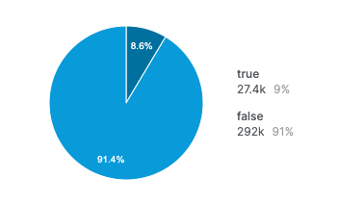
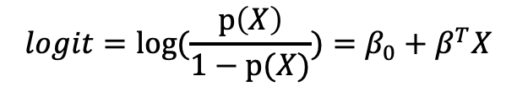
Parametric Model
Logistic regression
Dataset partition: 80% for training, 20% for independent testing
Training strategy: 10-Fold cross-validation.
Logistic regression model:
Heart Disease
Use sampling strategy to cope with unbalanced data
$$logit=log(\frac{p\left(X\right)}{1−p(X)})=β_{0}+β^{T}X$$
Oversampling: sample positive data repeatedly
SMOTE: generate new positive samples based on KNN
Table 1 Cross validation results of logistic regression models with different sampling strategies
ROC | Sens | Spec | Sampling
0.8410±0.0039 | 0.1114±0.0042 | 0.9911±0.0008 | None
0.8412±0.0016 | 0.7792±0.0027 | 0.7482±0.0025 | Oversampling
0.8455±0.0017 | 0.7793±0.0031 | 0.7614±0.0023 | SMOTE
Notes:
第二部分，我们首先选择建立参数模型来预测患心脏病的风险，将数据集划分为80%的训练集和20%的独立测试集，在训练集上使用10折交叉验证来进行模型评估。值得注意的是，数据集中患心脏病的人群仅占9%，所以我们想采用一些sampling的方法来处理分类不平衡的数据，比如过采样对数量较少的正样本进行重复采样；SMOTE则基于K近邻的方法合成新的正例，相对来说能缓解对正例的过拟合。从逻辑回归的结果来看，不进行过采样的话，预测的敏感度和特异度之间存在巨大的gap，11%的敏感度就意味着真正患心脏病人群中仅有11%能被模型预测发现。而过采样方法能有效平衡预测的敏感度和特异度，SMOTE的ROC等指标又相对更好，因此之后的模型都是在经SMOTE过采样后的数据集上训练的。

Slide 8
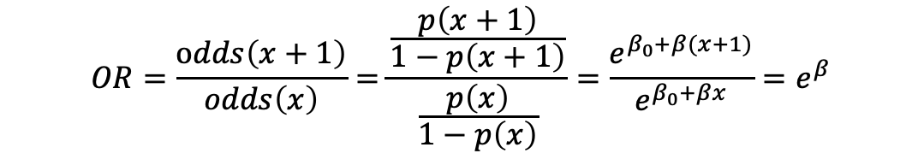
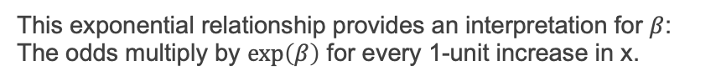
Parametric Model
Logistic regression
Odds ratio:
$$OR=\frac{odds\left(x+1\right)}{odds\left(x\right)}=\frac{\frac{p\left(x+1\right)}{1−p\left(x+1\right)}}{\frac{p\left(x\right)}{1−p\left(x\right)}}=\frac{e^{β_{0}+β(x+1)}}{e^{β_{0}+βx}}=e^{β}$$
This exponential relationship provides an interpretation for $β$:
The odds multiply by $exp\left(β\right)$ for every 1-unit increase in x.
Observations:
Odds of people having stroke is 3.41 times larger than those not having stroke.
Odds of male is 2.41 times larger than female.
The odds multiply by 1.36 for each 5-year increase in age.
Odds of Asian people is 0.48 times as large as white people.
The odds multiply by 0.55 for a better assessment on general health (e.g. from Fair to Good).
Other predictors like kidney disease, diabetic, smoking raise the risk of heart disease.
Notes:
在逻辑回归中，odds ratio优势比是一个相当重要的解释模型参数beta的量，预测变量每升高1个单位，则对应的odds会是原来的exponential beta倍。基于右图中每个变量对应odds ratio估计值和95%置信区间的结果，我们发现中风人群患心脏病的odds是非中风的3.41倍，男性的odds是女性的2.41倍，亚裔人群则是白人的一半左右。年龄上每增大五岁，患心脏病的odds会是原来的约1.36倍；general health 的健康状态提升一个等级，患病的odds也几近减半。其它像肾病、糖尿病、吸烟等预测变量也会提高患心脏病的风险。

Slide 9
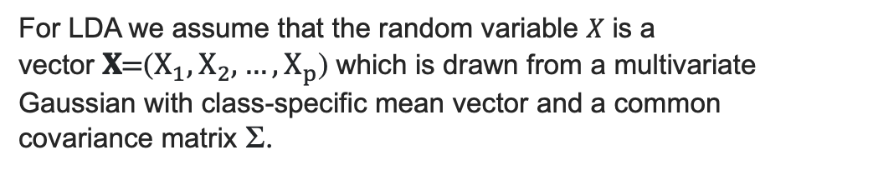
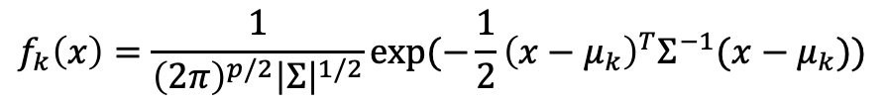
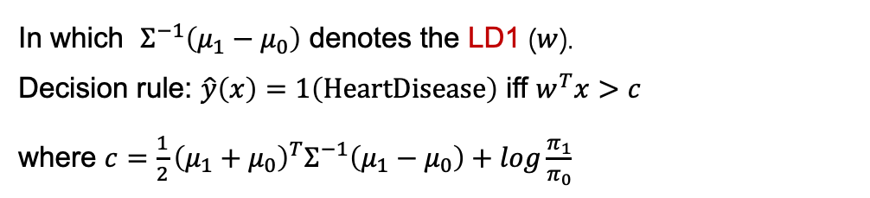
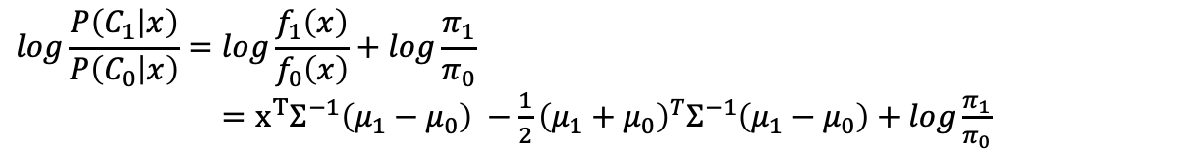
Parametric Model
Linear discriminant analysis
For LDA we assume that the random variable 𝑋 is a vector 𝐗=($X_{1},X_{2},…,X_{p}$) which is drawn from a multivariate Gaussian with class-specific mean vector and a common covariance matrix Σ.
$$f_{k}\left(x\right)=\frac{1}{{\left(2π\right)}^{p/2}{\left|Σ\right|}^{1/2}}\exp{(−\frac{1}{2}{\left(x−μ_{k}\right)}^{T}Σ^{−1}(x−μ_{k}))}$$
The linear decision boundary for binary classification:
$$log\frac{P\left(C_{1} | x\right)}{P\left(C_{0} | x\right)}=log\frac{f_{1}\left(x\right)}{f_{0}\left(x\right)}+log\frac{π_{1}}{π_{0}}$$
$=x^{T}Σ^{−1}\left(μ_{1}−μ_{0}\right) −\frac{1}{2}{\left(μ_{1}+μ_{0}\right)}^{T}Σ^{−1}\left(μ_{1}−μ_{0}\right)+log\frac{π_{1}}{π_{0}}$
In which $Σ^{−1}\left(μ_{1}−μ_{0}\right)$ denotes the LD1 ($w$).
Decision rule: $\hat{y}\left(x\right)=1\left(\text{HeartDisease}\right)$ iff $w^{T}x>c$
where $c=\frac{1}{2}{\left(μ_{1}+μ_{0}\right)}^{T}Σ^{−1}\left(μ_{1}−μ_{0}\right)+log\frac{π_{1}}{π_{0}}$
Model | ROC | Sens | Spec
LDA | 0.8451±0.0025 | 0.7897±0.0022 | 0.7516±0.0035
Notes:
线性判别分析假设随机变量X来自于多元正态分布，所以我们在预处理中对预测变量都进行了标准化standardization。在二分类问题中，线性的决策边界可以由两个类别后验概率的比值来表示，其中sigma逆乘mu1-mu2即是LD1，代表投影方向的向量w。如果w乘以x大于判别值c（这里约等于-0.04）则表示预测为心脏病患者。右图中可视化了每个变量对应的LD1数值，大致与同响应变量相关性、odds ratio的排列吻合（表现出年龄、性别、中风、general health等比较重要），模型交叉验证的表现也和逻辑回归差不多，ROC约等于0.845。

Slide 10
Non-parametric Model
Random forest
Number of variables used in a tree is set to the square root of the number variables (4).
Split rule: gini impurity
Number of trees: 500
Maximal tree depth: 6
Gradient boosting
Number of trees: 100
Shrinkage parameter: 0.1
Number of splits in each tree: 1 (additive model)
Model | ROC | Sens | Spec
RF | 0.9279±0.0012 | 0.8429±0.0040 | 0.8404±0.0052
GBM | 0.8980±0.0013 | 0.8134±0.0029 | 0.8125±0.0024
Variable importance based on random forest model
Notes:
之后我们又训练了两个非参数模型随机森林和Gradient boosting，选择的超参数比如树的数目、分割标准都列在slide中，其中Gradient boosting每个树的split为1等价于一种加性模型。从ROC、敏感度和特异度来看，它们在交叉验证中的表现相对参数模型更好一些，另外我们还可以可视化随机森林模型的variable importance，发现重要的几个预测变量也包括年龄、general health、性别、糖尿病等。

Slide 11
Performance Comparison
Parametric models (LR, LDA) achieve better AUC and sensitivity for heart disease risk prediction.
Non-parametric models produce higher specificity and F1-score.
Logistic regression is preferred for this problem due to the importance of identifying potential patients and interpretability
Notes:
最后，我们在独立测试集上比较了各个模型的表现，画了每个模型对应的ROC曲线和accuracy F1-score等评估指标的柱状图。可以发现逻辑回归、线性判别分析得到的AUC和敏感度更高；而非参数模型有更高的特异度和F1-score。但对于预测患心脏病风险这个任务来说，我们更偏向于选择敏感度更高，解释性更强的参数模型比如逻辑回归，因为我们希望尽可能多地找出有患心脏病风险的人群并进行早期有效的干预。

Slide 12
Conclusions
Construct machine learning models to predict the risk of Heart Disease from several health status descriptors for a person.
Explain the influence of predictors on Heart Disease through odds ratio, LD value and variable importance.
Use SMOTE sampling method to balance the prediction sensitivity and specificity, helping to detect more people having the risk of Heart Disease.
Age, general health, diff walking, smoking, diabetic, and stroke might be the key indicators on Heart Disease according to both correlation analysis and model results.
Notes:
总结一下，在这次project中我们构建了多种机器学习模型进行心脏病风险预测，通过odds ratio、LD value和variable importance对模型进行解释、采用SMOTE过采样方法平衡分类的敏感度和特异度，帮助发现更多有患病风险的人，最后根据相关性分析和模型的结果找到了年龄、general health、吸烟、糖尿病、行动困难、中风等心脏疾病的关键indicator。

Slide 13


Thank you！
Notes:
谢谢大家！

Slide 14
Personal Key Indicators of Heart Disease
--use machine learning to predict risk of heart disease
Group 2: Juman Huang, Xiaotong Lin, Yumeng Zhang
2022/5/26

